Slide 1

INDOOR PLANT MONITORING SYSTEM USING IOT
by
A. Likhitha
Roll No. 204G1A0548
R. Lalitha
Roll No. 204G1A0547
K. Asha Nidhi
Roll No. 204G1A0516
K. Hema Latha
Roll No. 204G1A0539
Under the guidance of
Dr. B. Harichandana_{M.Tech, Ph.D}
Associate Professor
Department of Computer Science and Engineering
Srinivasa Ramanujan Institute of Technology
Autonomous
Rotarypuram Village, B K Samudram Mandal, Ananthapuramu – 515701.
2023-2024

Slide 2

Contents
Abstract
Introduction
Literature Survey
Existing System
Proposed System
Planning
Design
Implementation
Result & Analysis
Conclusion
Research Paper
References

Slide 3
Abstract
Nowadays, a lot of individuals are quite interested in doing their own gardening. Indoor gardening has a variety of advantages, including the ability to produce organic vegetables, use of the plants in home design, and air purification. People's busy schedules are the major obstacle to indoor gardening because plants require more attention for their growth and health, necessitating the hiring of a "plant sitter" if they leave on vacation. This problem can be solved by automating the plant monitoring using the "Internet of Things". Utilizing Raspberry pi and variety of environmental sensors, and camera module, to track the temperature, moisture and many other aspects and providing data on each of these elements via PushBullet.
Keywords: Indoor planting, Plant sitter, Raspberry pi, Camera, PushBullet.

Slide 4
Introduction
Due to people's hurried lifestyles, indoor plants don't receive the attention they need, which has an effect on their growth and robustness.
To maintain the plant’s growth, a predetermined temperature, moisture, light and humidity levels as well as to spot bird activity, environmental factors must be continuously monitored and managed.
The problem can be minimized using IoT technology.
The Internet of Things (IoT) describes the network of physical object that are embedded with sensors, software, and other technologies for the purpose of connecting and exchanging data with other devices and systems over the internet.
Sensors play an important role in creating solutions using IoT.
Sensors are devices that detect external information, replacing it with a signal that humans and machines can distinguish.
IoT = Sensing + Communicating + Computing

Slide 5
Literature survey
In emphasizing the crucial role of Raspberry Pi integration, Zuraida Muhammad, Muhammad Azri and Asyraf Mohd Hafez, position it as the unifying core for the sensor array [1]. This integration, vital for seamless communication and control, aligns precisely with their technical emphasis on efficient data processing. Additionally, the authors highlight the significance of soil moisture sensors in maintaining optimal moisture levels for nutrient absorption and preventing water stress. The concise focus on Raspberry Pi integration resonates with their insights on elevating overall system robustness.

Slide 6
Literature survey
In the work on the Utilization and Applications of IoT (Internet of Things), Prof. Ms. P. V. Dudhe, Prof. Ms. N. V. Kadam, Prof. R. M. Hushangabade, and Prof. M. S. Deshmukh [6] offer profound technical insights. The authors intricately navigate the expansive realm of IoT applications, shedding light on its transformative impact across various sectors. Their analysis spans smart homes, industrial automation, and beyond, presenting a comprehensive understanding of the technical nuances that define the landscape of IoT deployment.

Slide 7
Literature survey
Highlighting a sensor-driven system perfected for precise detection of humidity, temperature, and soil moisture, this research, led by Yogeshwari Barhate and Mr. Rupesh Borse, integrates IoT for automated irrigation and real-time plant monitoring [2]. Offering insights into optimal sustainability parameters, the system seamlessly delivers data to users through smartphones or laptops, eliminating the need for manual intervention and reducing the risk of errors [4].

Slide 8
Literature survey
Structured into three integral components, the system encompasses animal detection and identification (for discerning animal presence), an alarm system (activating a buzzer for animal deterrence), and a GSM module (for notifying authorized personnel) [3]. Upon animal detection, the sensor triggers distance calculation, prompting the camera to capture images. These images, supervised by Selvamuthukumaran and Evangeline Sneha, undergo comparison with a stored dataset for precise animal identification. Upon surpassing a predefined distance threshold, the buzzer activates, and an alert message is transmitted to designated recipients [5].

Slide 9
Literature survey
Illuminating the application of PushBullet in plant monitoring systems, the study showcases its widespread adoption as a convenient approach for remotely overseeing and managing plant conditions [4]. The discussion underscores PushBullet's prevalence as a user-friendly and effective IoT platform, empowering users to craft personalized mobile applications tailored to their IoT ventures.

Slide 10
Existing System
The existing system monitors the environmental conditions using various sensors.
The system uses NodeMCU as microcontroller. NodeMCU comes with the inbuilt ESP8266 WiFi-module which connects our system to blynk app using WiFi. The program which controls the functioning of the whole system is fed into the microcontroller using Arduino IDE which is an environment which integrates code with the hardware. Soil moisture sensor continuously detects the level of moisture in the soil and displays it on the Virtual LCD widget on the Blynk app. If the water content in the soil is less than what is required by the plant, a notification is sent to the user’s smartphone and he/she can switch ON the button widget in Blynkapp which will turn ON the water supply. Real time values from the DHT11 temperature sensor are also displayed on the virtual LCD.

Slide 11
Existing System
The user is notified about each and every step through the notification feature of the Blynkapp. Hence, this system monitors and controls the plants requirements remotely.
Drawbacks of the existing system:
In this system In this system shade is not provided when temperature is high.
This system doesn’t provide the water automatically, user should manually on and off the pump using the app.
This system doesn’t detect the birds if they harm the plants.

Slide 12
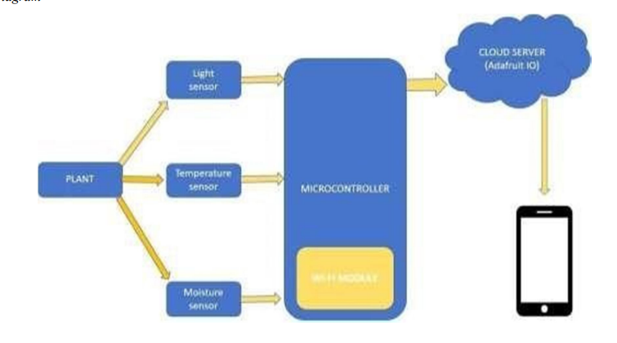
Existing System
Architecture of the Existing System

Slide 13
Existing System
SOFTWARE AND HARDWARE USED:
Software:
Arduino IDE
Hardware:
Microcontroller - NodeMCU
Light Sensor - Passive sensor
Moisture sensors
DHT 11 Sensor
Power supply (+5V power supply)

Slide 14
Proposed System
The system employs DHT11 and soil moisture sensors for data acquisition, with the Raspberry Pi as the processing hub, transmitting data to PushBullet. A relay module automates watering when soil moisture falls below a set threshold. Temperature data from DHT11 is also integrated. The relay module synchronizes with the Raspberry Pi to activate a mini pump for precise plant hydration. The Raspberry Pi ensures responsive control by signalling the relay module when the desired moisture level is achieved.
An integrated camera system, connected to a Raspberry Pi, utilizes MobileNetV2 architecture for real-time object detection. Pretrained on ImageNet, it identifies household animals and birds, activating a buzzer for bird deterrence. This enhances continuous monitoring and defends indoor plants with advanced object detection.

Slide 15
Proposed System
NOTE: Temperature and Humidity Reference
Vegetative phase – 25 degrees Celsius and 60-70% humidity.
Flowering phase – 28 degrees Celsius and 40-50% humidity.
NOTE: Soil Moisture Reference
It is important to note that the majority of flowers, trees, and shrubs require moisture levels between 21% - 40%, while all vegetables require soil moisture between 41% and 80%.

Slide 16
Planning
Objective
The main objective of this system is to provide shade when temperature is high also water automatically and to protect the indoor plant from bird activity.
Scope
Alert the person by providing Buzzer sound when a bird comes.
Provide shade and water automatically to the plant.
Display a notification message on mobile device of moisture, temperature based on a certain threshold and bird activity.
Performance
The performance of the system is increased by using Raspberry Pi 4 as it is a powerful quad-core Cortex-A72 CPU with dual-band Wi-Fi, Gigabit Ethernet, Bluetooth 5.0, 2x USB 3.0 ports, and 2x USB 2.0 ports for versatile connectivity.

Slide 17
Planning
HARDWARE AND SOFTWARE REQUIREMENTS:
Hardware | Software
Microcontroller (Raspberry Pi 4B) | Raspbian OS
DHT11 Sensor | VNC Viewer
Moisture Sensor | Thony IDE
Camera module | Push bullet
Servo motor | RAM: 4GB and above
Water Pump | Memory: 8GB and above
Relay module | Processor I4 and above
Buzzer
Power Supply (+5V)

Slide 18
Planning
Functional Requirements
To continuously measuring the humidity, temperature and moisture content by tracking the soil moisture and temperature levels.
To provide water when moisture level is low by using pump and adjusting to temperature level. When bird is detected, it identifies with previous dataset and buzzer sounds an alarm.
To send notifications through push bullet app when all these activities are notified.
Non Functional Requirements
Usability
This project enables users to remotely control certain aspects of the system through the app, such as watering plants if necessary.
Portability
Push bullet app is accessible and functional across various mobile devices and platforms for remote monitoring from anywhere.
Speed
This project is speed in sending alert messages to the user for the respective bird activities and condition of the plant.

Slide 19
Planning
Methodology
To implement this project Iterative model is used. It involves continuous cycle of Planning, Analysis, Implementation and Evaluation.
Each cycle produces a segment of development that forms the basis for the next cycle of iterative development.
Advantages:
It is easily acceptable to ever-changing needs of the project.
Testing and debugging during smaller iteration is easy.
A parallel development can plan.

Slide 20
Planning
Cost Estimation
S.No | Component | Cost (Rs) | No of Pieces Required | Total Cost (Rs)
1 | Raspberry Pi 4 | 5000 | 1 | 5000
2 | DHT11 Sensor | 150 | 1 | 150
3 | Soil Moisture Sensor | 108 | 1 | 108
4 | Buzzer | 20 | 1 | 20
5 | Water Pump | 250 | 1 | 250
6 | Camera Module | 1250 | 1 | 1250
7 | Servo Motor | 200 | 1 | 200
8 | Jumper Wires | 10 | 1 | 90
9 | Soldering | 10 | 40 | 500
10 | Shipping | 400 | - | 400
 | Total Cost |  |  | 7968

Slide 21
Planning
Time Estimation
S. N0 | Activity | Duration
1 | Gathering all the Components | 1 Week
2 | Developing the Environmental checking system (Module 1) | 3 Weeks
3 | Developing the Bird detection System (Module 2) | 4 Weeks
4 | Implementing the System | 1 Week
5 | Rectifying the drawbacks and Finalizing the System | 1 Week

Slide 22
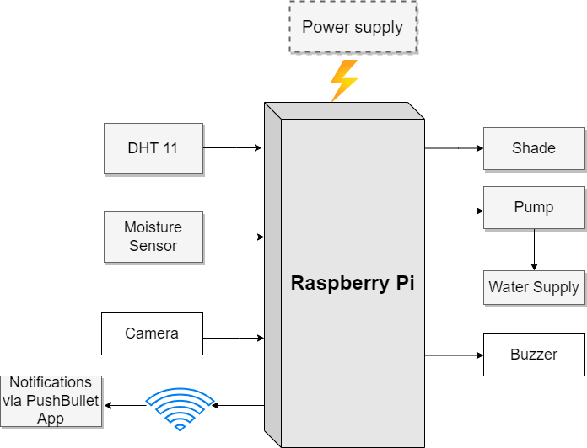
Design
Architecture of proposed system

Slide 23
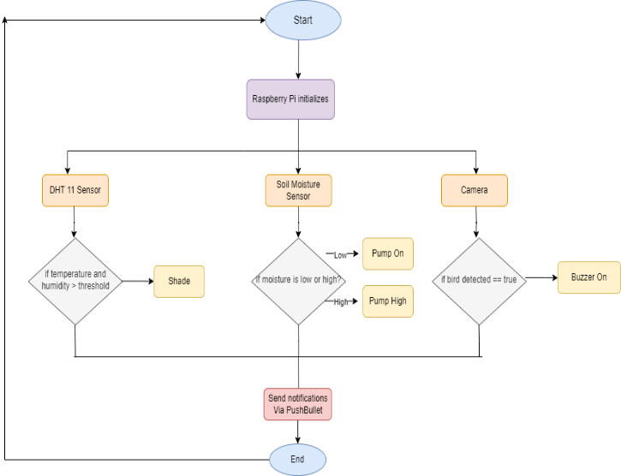
Design
Flow Chart of Proposed System

Slide 24
Implementation
Module -1: Checking environmental conditions
This module is to detect the various conditions of the plant and send notification through PushBullet. The DHT11 sensor is used to detect the humidity and temperature of the surroundings and sends information to the raspberry pi and notifies if the humidity and temperature are greater than threshold. The soil moisture sensor detects the moisture content in the soil and this information is sent to raspberry pi then it instructs the water pump to automatically pump the water to the plants if the moisture is low.
Pump Activation= 1 if moisture<threshold ​
0 Otherwise (1)
Pump Activation Signal=PumpActivation×Relay Signal (2)

Slide 25
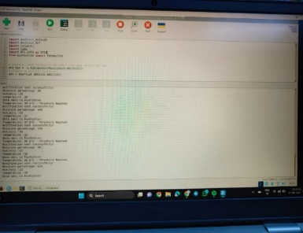
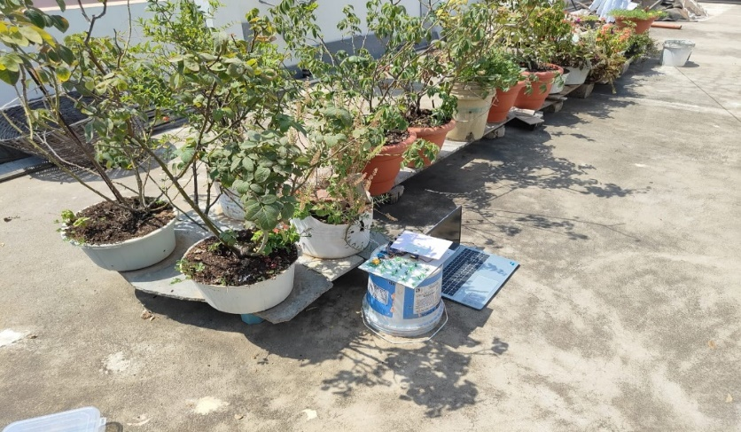
Implementation
Implementation of DHT11 and Soil Moisture Sensor

Slide 26
Implementation
Module -2: Bird detection
The second module is to detect the bird activity. This is done using the camera module. The camera detects the bird coming near to the plant and sends information to the raspberry pi then it instructs the buzzer to make sound which results in flying away. This prevents the plant from being affected from bird activity.

Slide 27
Implementation
Module -2: Bird detection
MobileNetV2 is a specific architecture of CNNs, designed to be lightweight and efficient, making it suitable for deployment on mobile and embedded devices. Here's a simplified overview of its architecture:
Depth-wise Separable Convolutions: MobileNetV2 primarily utilizes depthwise separable convolutions, which decompose the standard convolution operation into two separate operations: depth-wise convolution and pointwise convolution. This significantly reduces the number of parameters and computations required while preserving performance.
Inverted Residuals: MobileNetV2 introduces the concept of inverted residuals, which involves expanding the number of channels in bottleneck layers, applying depthwise convolutions, and projecting back to a lower-dimensional space. This architecture improves representational power while maintaining efficiency.
Linear Bottlenecks: Instead of using non-linear activation functions in bottleneck layers, MobileNetV2 employs linear bottlenecks. This simplification reduces computational cost and improves information flow through the network.

Slide 28
Implementation
This multi-faceted technical implementation significantly elevates the system's capabilities, providing a robust defense mechanism for indoor plants through advanced object detection functionalities and comprehensive environmental monitoring.

Slide 29
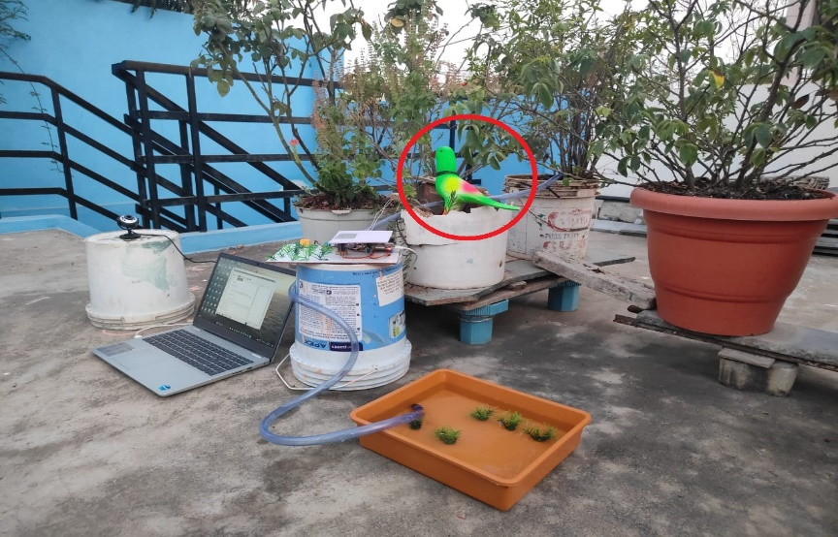
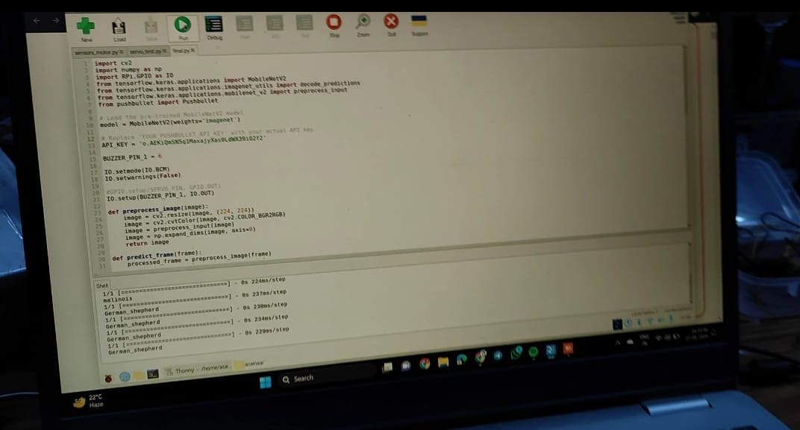
Implementation
Implementation of Bird detection

Slide 30
Implementation
Data Flow
- Sensors collect data -> Raspberry Pi processes data -> PushBullet for remote monitoring.
- Moisture level triggers relay -> Activates mini-DC pump if watering is needed.
- Camera captures images -> MobileNetV2 identifies birds -> Buzzer activates to deter birds

Slide 31
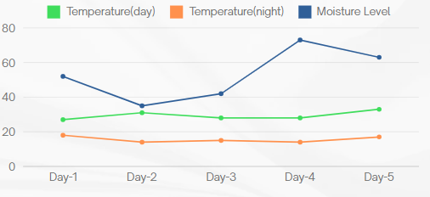
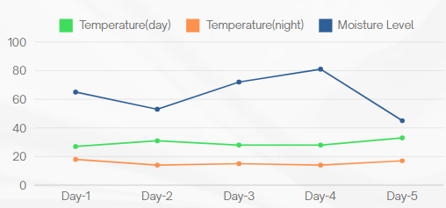
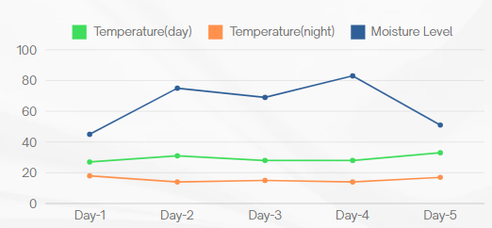
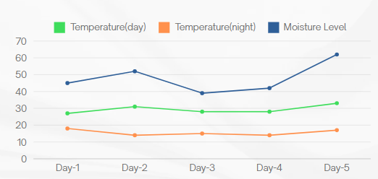
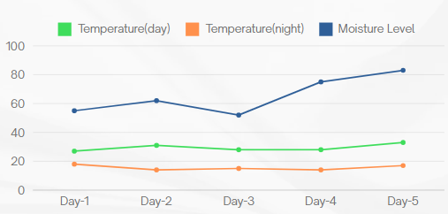
Results & Analysis
Analysis of different plants
Fig 1: Rose plant results
Fig 2: Chrysanthemum plant results
Fig 3: Basil plant results
Fig 4: Table Rose plant results
Fig 5: Brinjal plant results

Slide 32
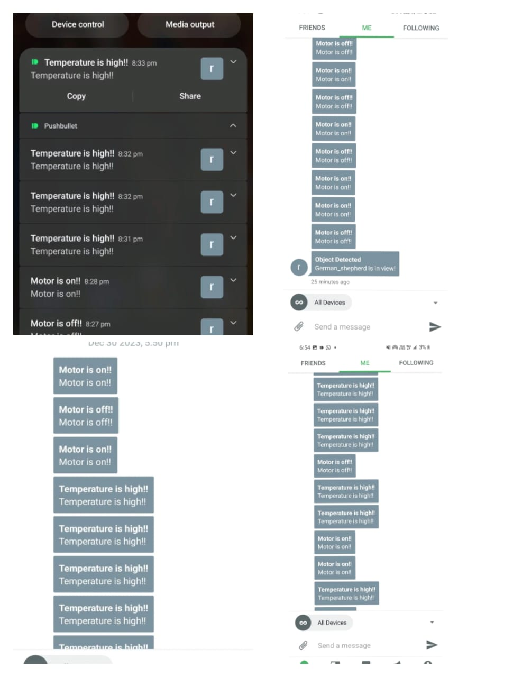
Results & Analysis
PushBullet in-app notifications

Slide 33
Conclusion
The Raspberry Pi and IoT-driven automated indoor plant monitoring system efficiently tackles challenges posed by busy schedules in plant care. Through the automation of monitoring via moisture and DHT11 sensors, alongside a camera, the system enables remote observation and data transmission using PushBullet. This technological advancement not only supports organic vegetable cultivation and improves home aesthetics but also eliminates the necessity for 'plant sitters' during absences. The work highlights the harmonious integration of technology and gardening, providing a practical and efficient solution for modern lifestyles, with potential for further technical enhancements in the future.

Slide 34
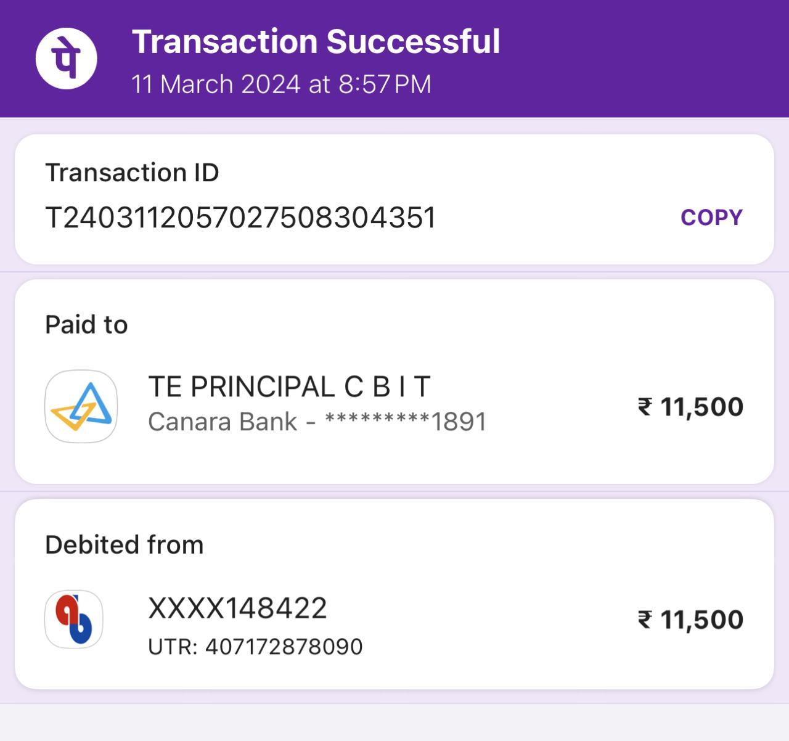
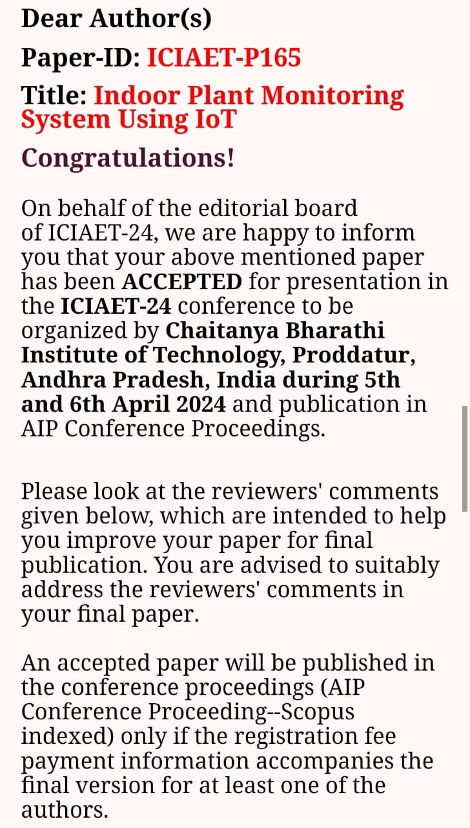
Research Paper
Research Paper

Slide 35
References
[1]. Zuraida Muhammad, Muhammad Azri Asyraf Mohd Hafez, Nor Adni Mat Leh, Zakiah Mohd Yusoff and Shabinar Abd Hamid, “Smart Agriculture Using Internet Of Things with Raspberry Pi”, 10th IEEE International Conference on Control System, Computing and Engineering (ICCSCE2020) pp. 85-90, August. 2020.
[2]. Ms. Yogeshwari Barhate, Mr. Rupesh Borse, Ms. Neha Adkar and Mr. Gaurav Bagul, “Plant Watering and Monitoring System Using IOT and Cloud Computing” International Journal of Scientific Development and Research vol. 5, pp. 157-162, April. 2020.
[3]. Selvamuthukumaran N, Evangeline Sneha J, Thriambika K B and Vishali Babu B, “Intelligent Animal Detection System Using IOT and Deep Learning” International Research Journal of Modernization in Engineering Technology and Science, vol. 3, pp. 2433-2438, April. 2021.
[4]. Yogesh kumar Jayam, Venkatesh Tunuguntla, Sreehari J B, S Harinarayanan , “Smart Plant Monitoring System Using IOT” Fourth International Conference on Trends in Electronics and Informatics (ICOEI 2020),pp. 271-277, July. 2020.
[5]. Gaurav Patil, Akash Patil, Shashank Pathmudi, Plant Monitoring System International Journal of Engineering Research & Technology (IJERT), vol.10, pp. 1-4, September 2021.
[6]. Prof.Ms.P.V.Dudhe, Prof.Ms.N.V.Kadam, Prof. R. M. Hushangabade, Prof. M. S. Deshmukh, Internet of Things (IOT): An Overview and it’s Applications International Conference on Energy, Communication, Data Analytics and Soft Computing (ICECDS-2017), pp. 2650-2653, 2017.

Slide 36
References
[7]. R Lathesparan, A Shranjah, R Thushanth, S Kenurshan, MNM Nifras and WU Wickramaarachi, Real-time Animal Detection and Prevention System for Crop Fields, 13th Internationl Research Conference General Sir John Kotelawala Defence University, pp. 70-78, June 2021.
[8]. Y. Manoj, T. Sai Naveen Kumar, Sk Adeeb Jainab, T. Sailaja and A. Anasuyamma, Greenhouse Monitoring Using Raspberry Pi, International Journal of Creative Research Thoughts, vol. 11, pp. 429-433, May 2023.
[9]. Sachin Kumar, Pryag Tiwari, Mikhail Zymbler, Internet of Things is a revolutionary approach for future technology enhancement: a review, Springer Open, pp. 1-21, 2019.
[10]. Zainab H. Ali, Hesham A. Ali, Mahmoud M. Badawy, Internet of Things (IoT): Definitions, Challenges and Recent Research Directions, International Journal of Computer Applications, vol. 128-No 1, pp. 37-47, October 2021.
[11]. Radouan Ait Mouha, Internet of Things (IoT), Journal of Data Analysis and Information Processing, pp. 77-101, April 2021.
[12]. Muthumanickam Dhanaraju, Poongodi Chenniappan, Kumaraperumal Ramalingam, Sellaperumal Pazhanivelan and Raghunath kaliaperumal, Smart Farming: Internet of Things (IoT)-Based Sustainable Agriculture, MPDI, October 2022.

Slide 37
Thank You!!!

